Slide 1
The ART Symphony bot api
August 2019

Slide 2
What is Symphony
Secure Communications - All communication is encrypted from end to end. Only the users chatting and authorized auditors have the capability to decrypt messages.
Auditability - All communication is logged making auditability easier.
Compliance Mechanisms - The level of access a user has is highly configurable. This makes compliance potentially eaiser to achieve.
Global capabilities - The Symphony Platform is a global network and companies can communicate across departments and companies on a global scale.
Bots and Apps - As digitalization further increases bots can be used to automate workflows, increasing productivity
Web, Desktop and Mobile applications - Symphony comes as a web-app, a desktop-app or a smartphone-app.

Slide 3
Chatbots
A bot is an automated system user that performs tasks and exists inside of an application running within your own infrastructure
/Symphony

Slide 4
BOT demos
Bot demos:
SymbolMapperBot
IRSPricingBot

Slide 5
Arcitecture overview
Your Application
Pod
Symphony API
ART Bot Api
Key Manager
Agent
Key Manager

Slide 6
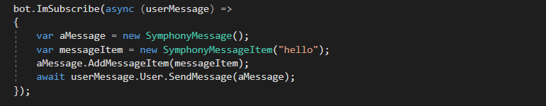
API overview

Slide 7
Authentication
Generate a JWT token with the following fields,
sub - The username of the bot
exp - The expiration time of this token.
Sign it with your private key
Send to Key Manager
Send to Pod
Use Session Token when interacting with Pod
Use Key Manager Token + Session Token when interacting with Agent
Recreate Tokens when they expire
All of this is handled by the ART Bot Api

Slide 8
ART Client – The Most Important Api Calls
MessageSentInRoomSubscribe
GetUserFromId
ImSubscribe
ListStreams
JoinRoom
WhenAddedToRoom
GetRoom
GetUser
SendMessageToStream

Slide 9
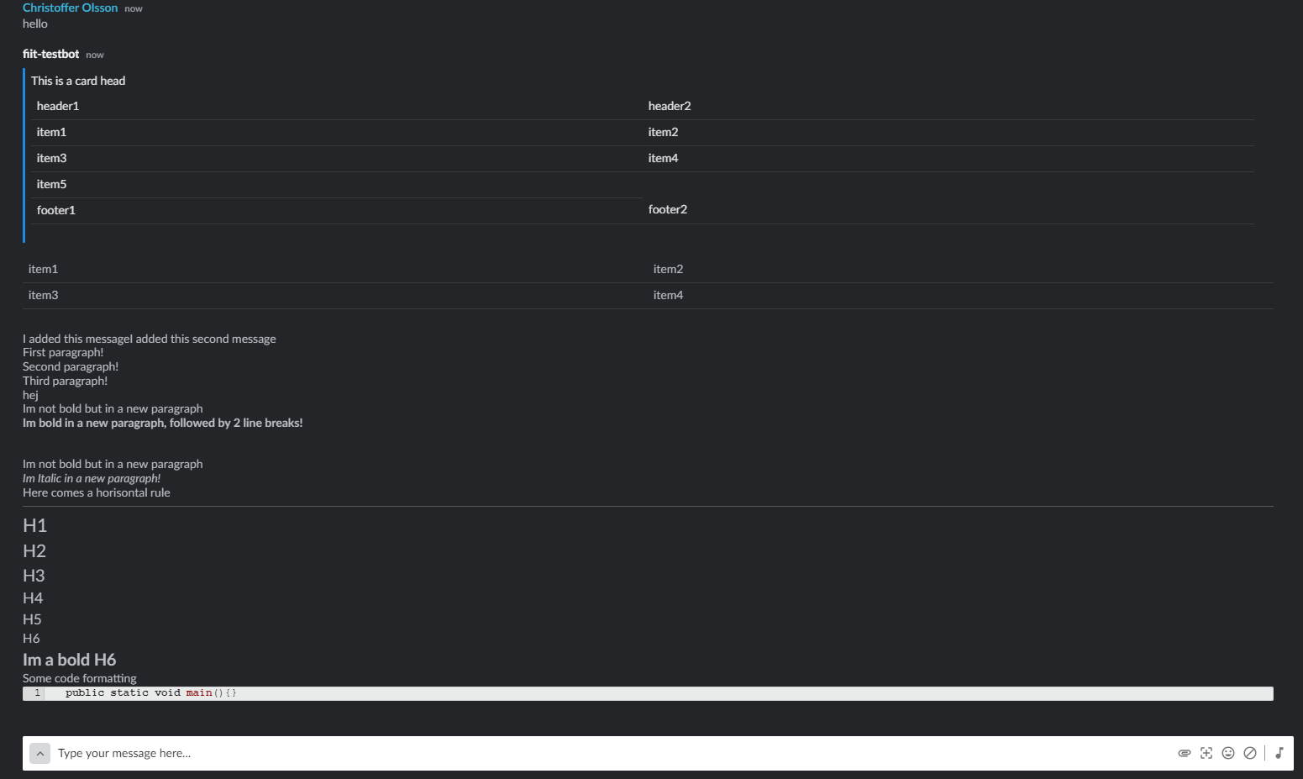
ART Client – Message Construction Example

Slide 10
ART Client Features
An abstraction over all the details of the Symphony Platform
Authentication
Re-Authentication
Message Construction
Abstracted Api Calls
Logging
Proxy-Capabilities
Extensible Api Calls

Slide 11
Resources
Symphony web page
ART Symphony API documentation
ART Symphony API repository

